Slide 1
De Novo Sequencing of MS Spectra
Only a manually confirmed spectrum is a correct spectrum
Beatrix Ueberheide
February 25th 2014

Slide 2
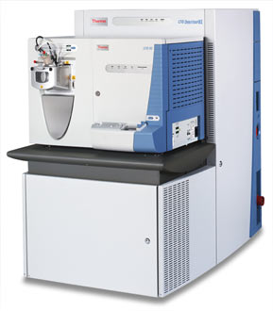
Biological Mass Spectrometry
Proteolytic digestion
Protein(s)
Peptides
Base Peak Chromatogram
MS
500
1000
1500
Time (min)
m/z
Mass Spectrometer
MS/MS
Database Search
Manual Interpretation
200
600
m/z
1000

Slide 3
Peptide Sequencing using Mass Spectrometry
S
G
F
L
E
E
D
E
L
K
100
% Relative Abundance
0
250
500
750
1000
m/z

Slide 4
Peptide Sequencing using Mass Spectrometry
88
145
292
405
534
663
778
907
1020
1166
b ions
S
G
F
L
E
E
D
E
L
K
100
% Relative Abundance
0
250
500
750
1000
m/z

Slide 5
Peptide Sequencing using Mass Spectrometry
S
G
F
L
E
E
D
E
L
K
1166
1080
1022
875
762
633
504
389
260
147
y ions
100
% Relative Abundance
0
250
500
750
1000
m/z

Slide 6
Peptide Sequencing using Mass Spectrometry
88
145
292
405
534
663
778
907
1020
1166
b ions
S
G
F
L
E
E
D
E
L
K
1166
1080
1022
875
762
633
504
389
260
147
y ions
762
100
875
[M+2H]²⁺
% Relative Abundance
633
292
405
534
260
389
1022
504
907
1020
663
778
1080
0
250
500
750
1000
m/z

Slide 7
Peptide Sequencing using Mass Spectrometry
88
145
292
405
534
663
778
907
1020
1166
b ions
S
G
F
L
E
E
D
E
L
K
1166
1080
1022
875
762
633
504
389
260
147
y ions
762
100
113
875
113
[M+2H]²⁺
% Relative Abundance
633
292
405
534
260
389
1022
504
907
1020
663
778
1080
0
250
500
750
1000
m/z

Slide 8
Peptide Sequencing using Mass Spectrometry
88
145
292
405
534
663
778
907
1020
1166
b ions
S
G
F
L
E
E
D
E
L
K
1166
1080
1022
875
762
633
504
389
260
147
y ions
762
100
129
875
[M+2H]²⁺
% Relative Abundance
129
633
292
405
534
260
389
1022
504
907
1020
663
778
1080
0
250
500
750
1000
m/z

Slide 9
Peptide Sequencing using Mass Spectrometry
88
145
292
405
534
663
778
907
1020
1166
b ions
S
G
F
L
E
E
D
E
L
K
1166
1080
1022
875
762
633
504
389
260
147
y ions
762
100
875
[M+2H]²⁺
% Relative Abundance
633
292
405
534
260
389
1022
504
907
1020
663
778
1080
0
250
500
750
1000
m/z

Slide 10
Peptide Sequencing using Mass Spectrometry
88
145
292
405
534
663
778
907
1020
1166
b ions
S
G
F
L
E
E
D
E
L
K
1166
1080
1022
875
762
633
504
389
260
147
y ions
762
100
875
[M+2H]²⁺
% Relative Abundance
633
292
405
534
260
389
1022
504
907
1020
663
778
1080
0
250
500
750
1000
m/z

Slide 11
Peptide Sequencing using Mass Spectrometry
88
145
292
405
534
663
778
907
1020
1166
b ions
S
G
F
L
E
E
D
E
L
K
1166
1080
1022
875
762
633
504
389
260
147
y ions
762
100
875
[M+2H]²⁺
% Relative Abundance
633
292
405
534
260
389
1022
504
907
1020
663
778
1080
0
250
500
750
1000
m/z

Slide 12
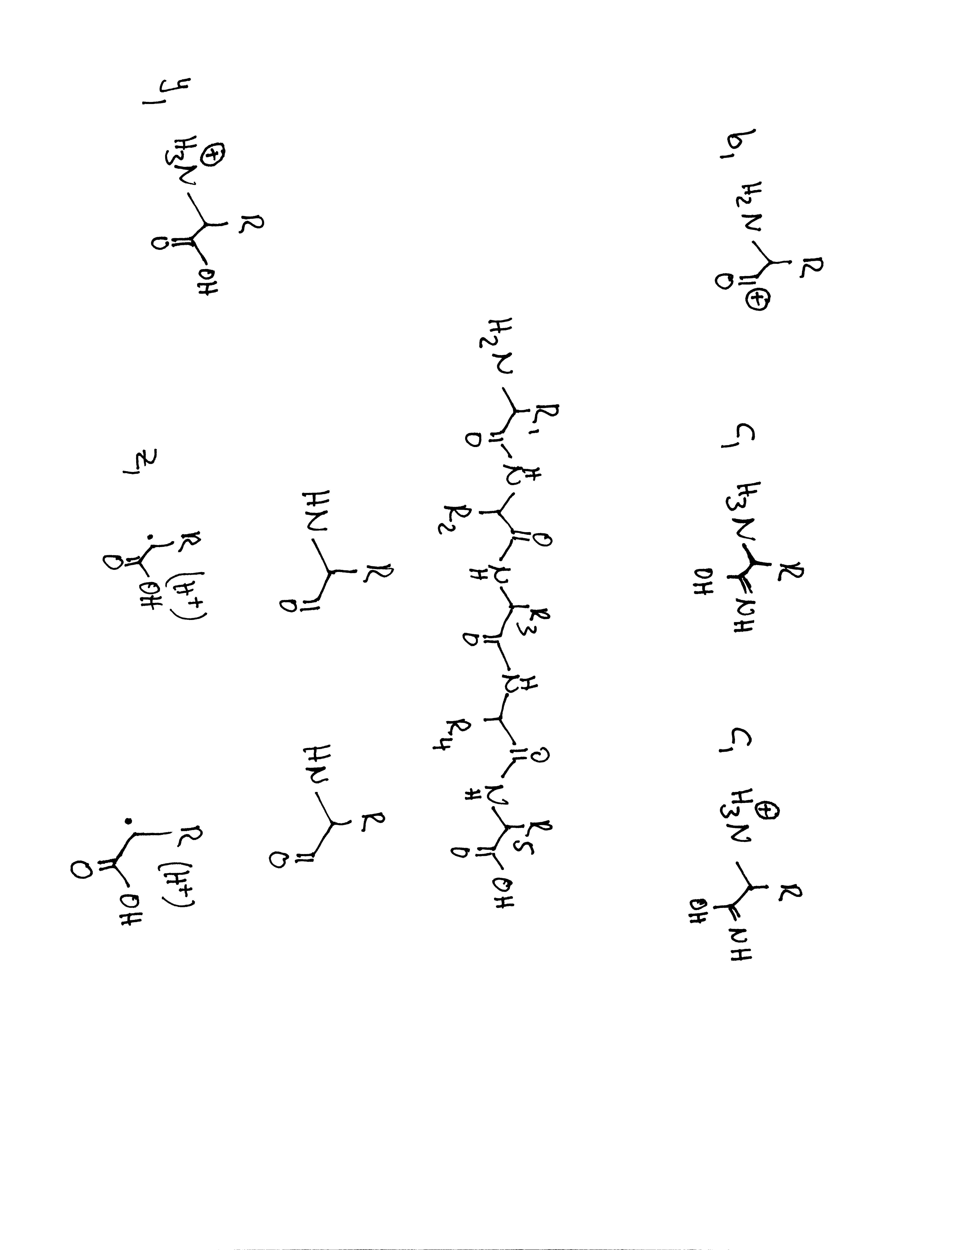
How to Sequence
Residue Mass (RM)
b ion
How to calculate the very first y ion
y ion
How to calculate the very first b ion?
y1 = RM +
19
b1 = RM +
1

Slide 13
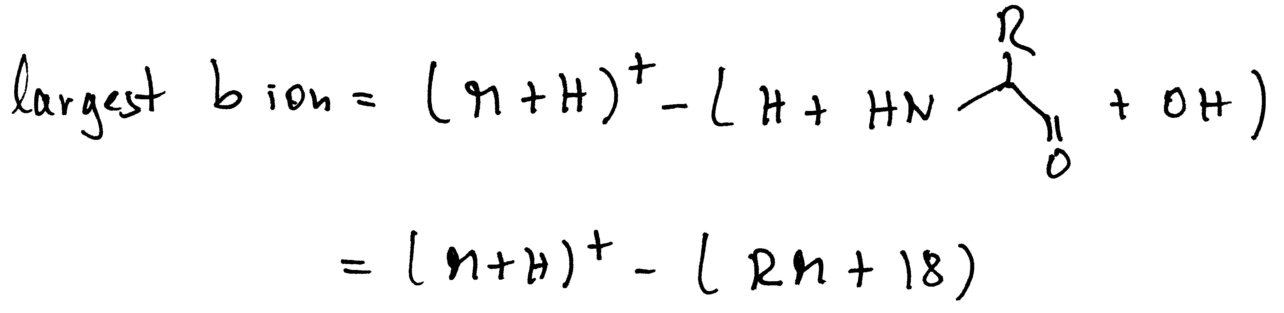
Example of how to calculate theoretical fragment ions
88
159
290
387
500
629
803
S A M P L E R
803
716
645
514
417
304
175
Residue Mass
The first b ion
The first y ion

Slide 14
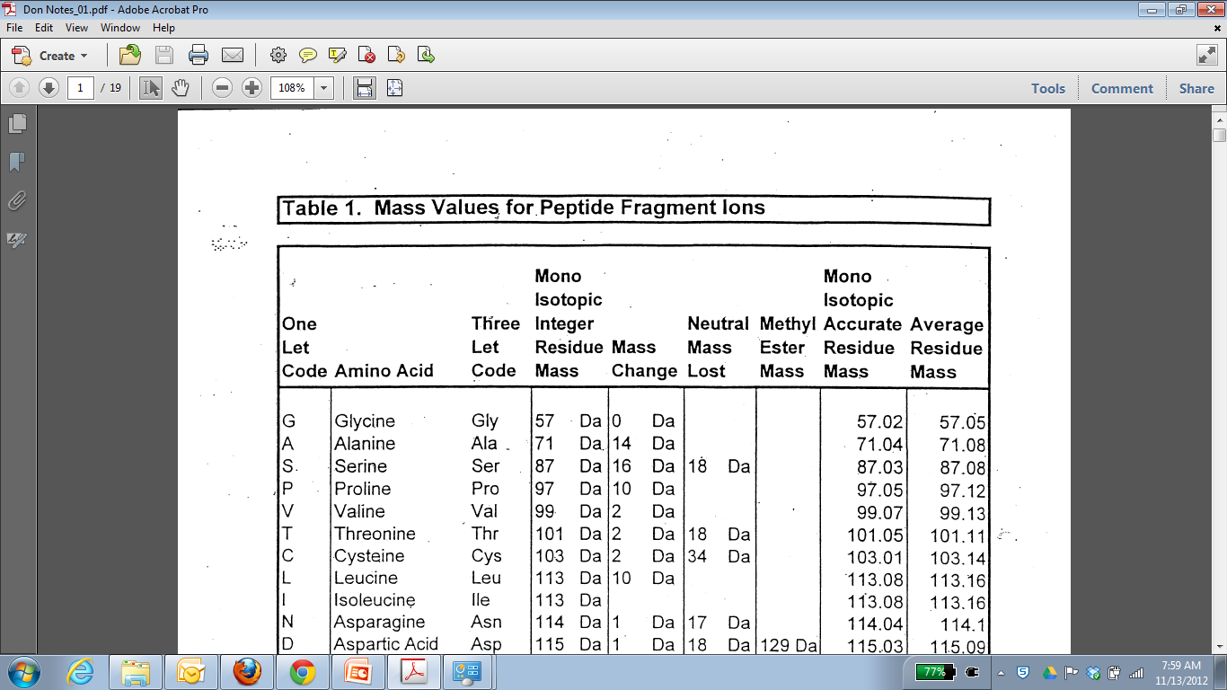
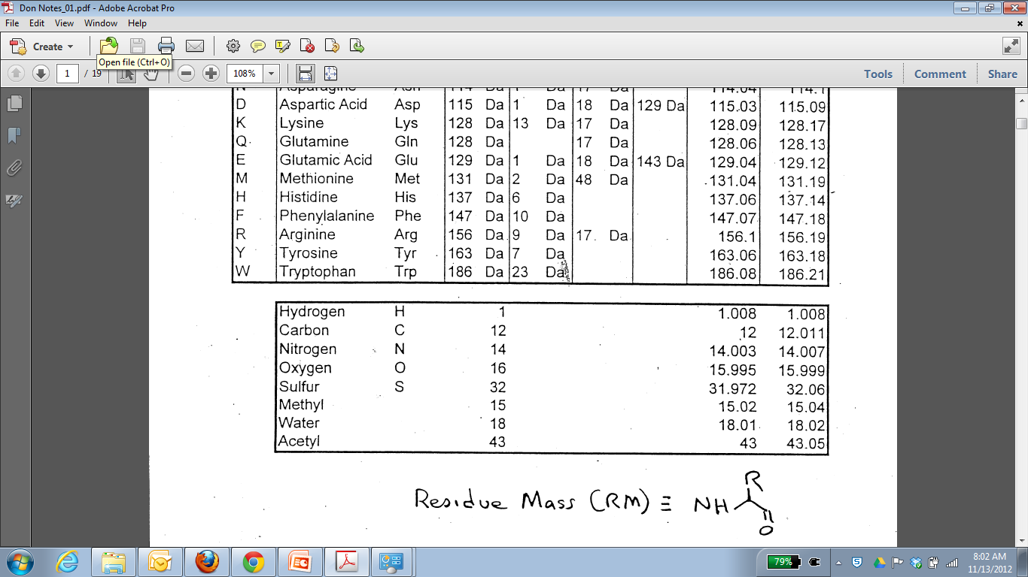
Observed neutral losses and mass additions:
Ammonia
Water
Carbon Monoxide from b ions
Phosphoric acid from phosphorylated serine and threonine
Carbamidomethyl modification on cysteines upon alkylation with iodoacetamide

Slide 15
First Example

Slide 16
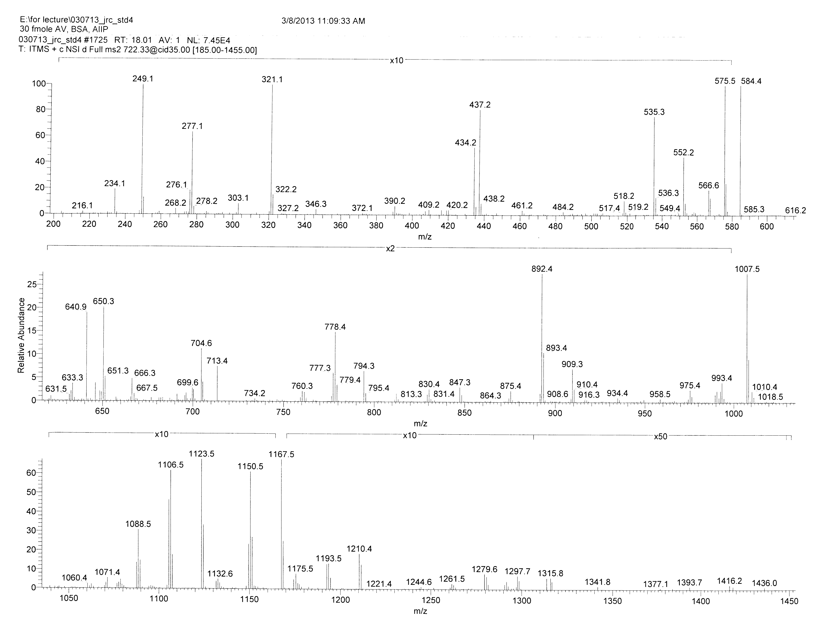
What is the charge state?
Neutral loss of water
Water = 18; 18/2; 9
Neutral loss of water?
Find with b/y pairs!

Slide 19
Search for ‘biggest ion’
1433-18-RM
1433-18- a residue after which an enzyme cleaves
1433-18-156 = 1249
1433-18-128 = 1297

Slide 20
1297
1433
K
147

Slide 21
1210
1297
1433
S
K
1433
87
234
147

Slide 22
Find the biggest y ion!
Peptide Mass – RM
Lowest possible ion = Glycine
Highest possible ion = Tryptophan
Glycine = 1443-57 = 1386
Tryptophan = 1443-186 = 1257
164
1210
1297
1433
Y
S
K
1433
1280
87
234
147
1443-163 = 1280

Slide 23
And the sequence is……..

Slide 24
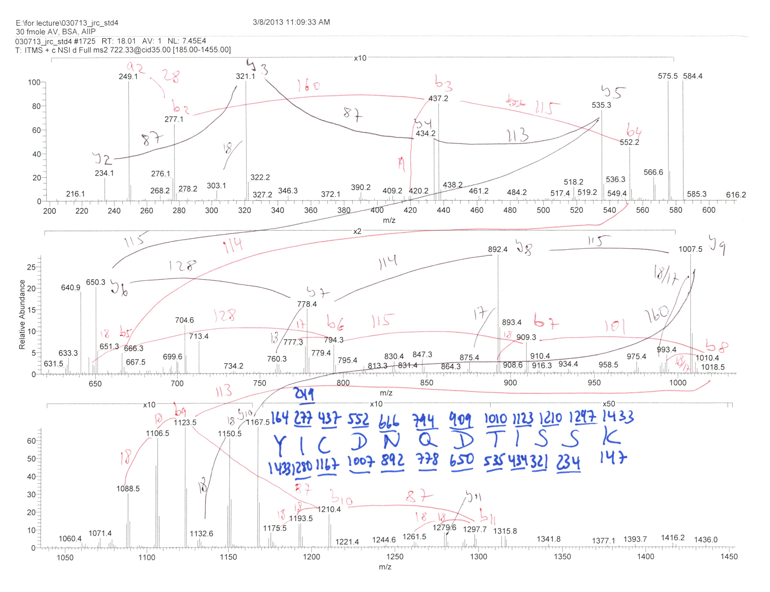

Slide 25
ETD
Electron Transfer Dissociation

Slide 26
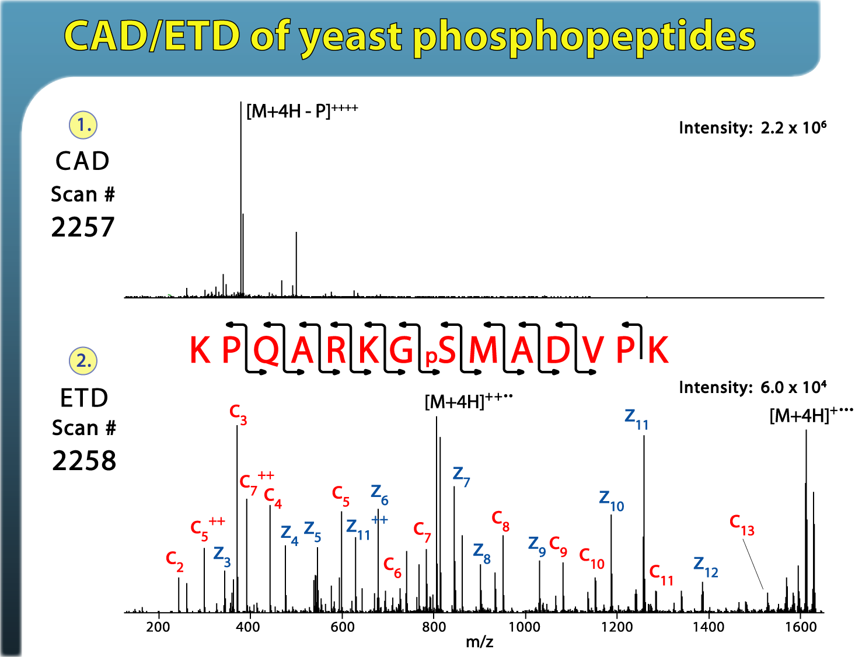
What if we do not get good fragmentation?

Slide 27
Try a different mode of dissociation

Slide 28
ETD

Slide 29
Electron Transfer Dissociation
+

Slide 30
Tandem MS - Dissociation Techniques
CAD: Collision Activated Dissociation (b, y ions)
⇒increase of internal energy through collisions
ETD: Electron Transfer Dissociation (c, z ions)
⇒bombardment of peptides with electrons (radical driven fragmentation)

Slide 31
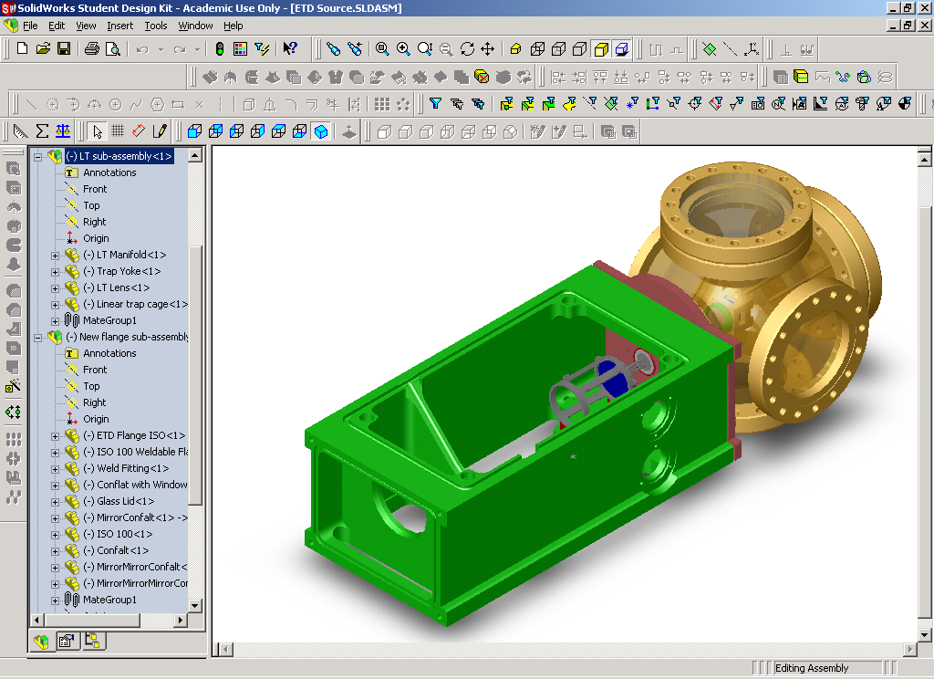
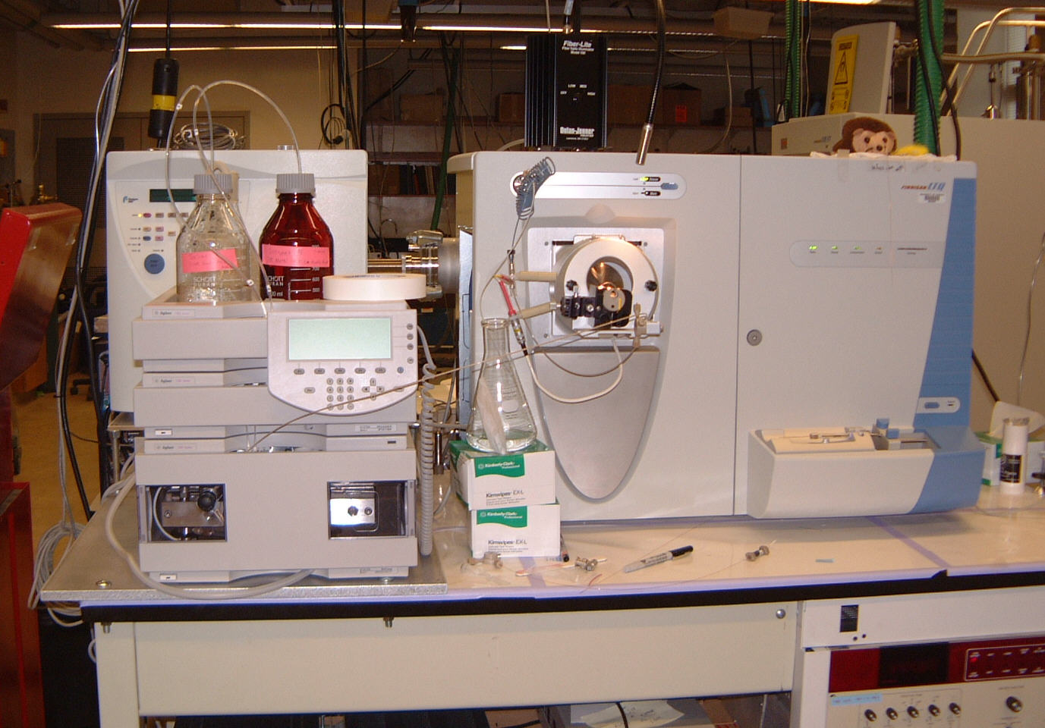
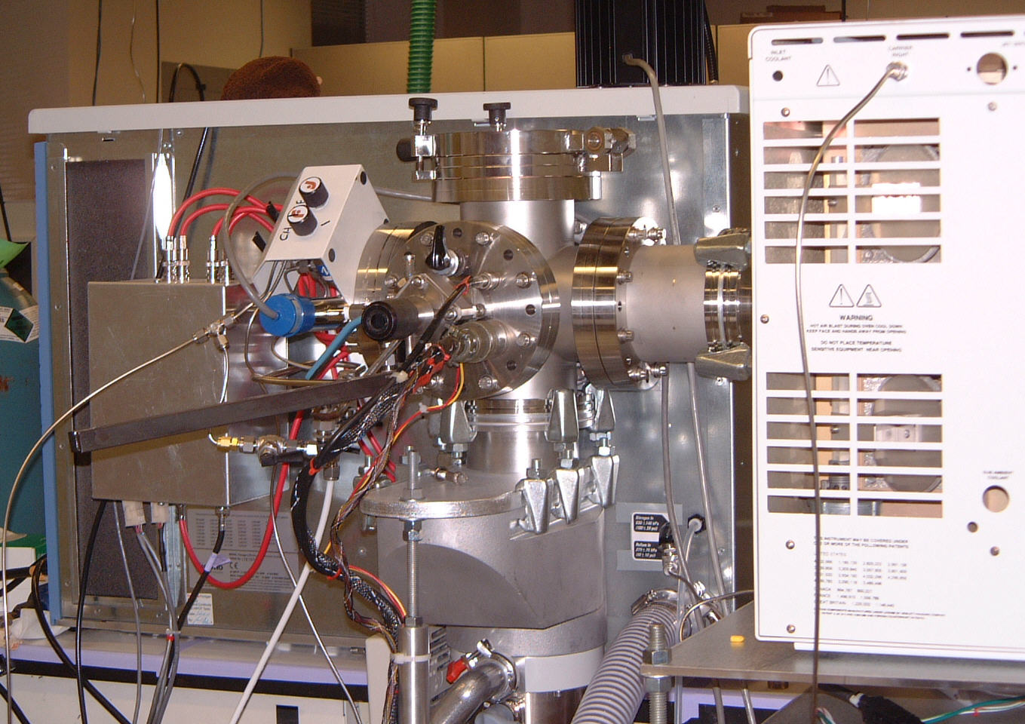
The Prototype Instrument
Modified rear / CI source
HPLC LTQ front

Slide 32
Modifications For Ion/Ion Experiments
Anion Precursor
(Fluoranthene)
Three Section
RF Linear Quadrupole Trap
Filament
e⁻
Cations
3 mTorr He
-
NICI
Source
+
Anions
From
ESI
Source
~700 mTorr
Ion
Detector
1 0f 2
Methane
Secondary RF Supply
0-150 V_{peak} @ 600 kHz

Slide 33
Injection of Positive Ions (ESI)

Slide 34
Precursor Storage in Front Section

Slide 35
Injection of Negative Ions (CI)

Slide 36
Charge-Sign Independent Trapping
Positive and negative ions react while
trapped in axial pseudo-potential
Pseudo-
potential
created by
+150 V_{p} 600 kHz
applied
to lenses
+
0 V
-

Slide 37
Charge sign independent radial confinement
0 V
+
-
Axial Confinement With DC Potentials
Trapping is Charge Sign Dependent

Slide 38
Charge sign independent axial confinement
with combined RF Quadrupole and
end lens RF pseudo-potentials
+
0 V
-

Slide 39
End ion/ion reactions
prepare for product ion analysis
Product Cations Trapped in
Center Section For Scan Out
+
+
+
+
+
0 V
-12 V
-
-
Reagent Anions
Removed Axially

Slide 40
Electron Transfer - Proton Transfer
Fragmentation(ETD)
100
+3
Precursor
50
0
200
400
600
800
1000
1200
1400
m/z

Slide 41
Electron Transfer - Proton Transfer
Fragmentation(ETD)
100
+3
Precursor
50
0
200
400
600
800
1000
1200
1400
m/z
Charge Reduction (PTR)
100
+2
+2
O
-
+3
Precursor
+1
50
+1
O
0
200
400
600
800
1000
1200
1400
m/z

Slide 42
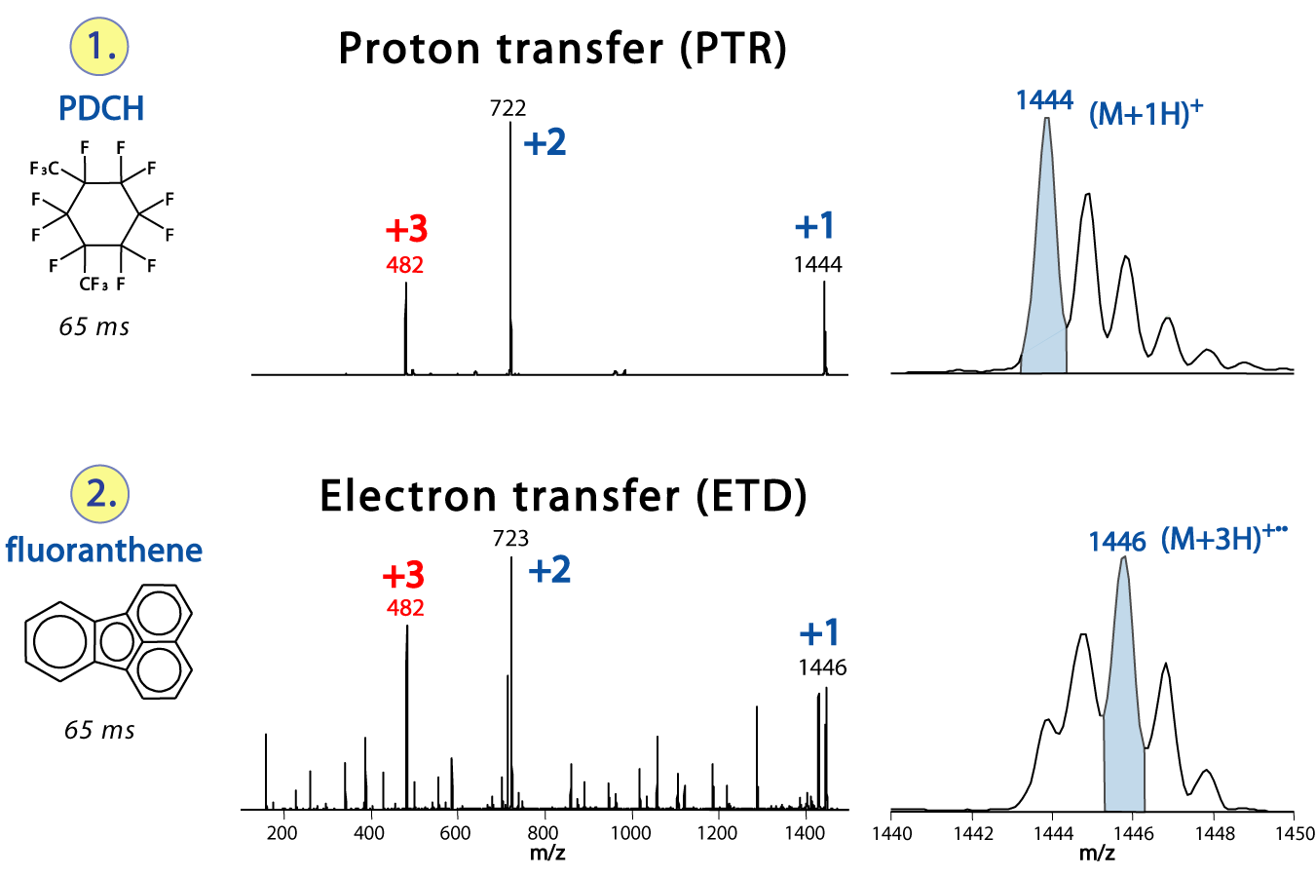
The two types of ion reactions

Slide 43
ET or ETD
[M + 3H]^{2+•}
Mass ?
m/z ?
Charge (z)
Sequence ?
Temperature ?
Anion ?
He Pressure?
Intact
Charge-Reduced
Products
Fragmentation
Products
c, z, etc.
[M + 3H]^{2+•}

Slide 44
ET or ETD
[M + 3H]^{2+•}
Mass ?
m/z ?
Charge (z)
Sequence ?
Temperature ?
Anion ?
He Pressure?
Intact
Charge-Reduced
Products
Fragmentation
Products
c, z, etc.
[M + 3H]^{2+•}
CAD

Slide 45
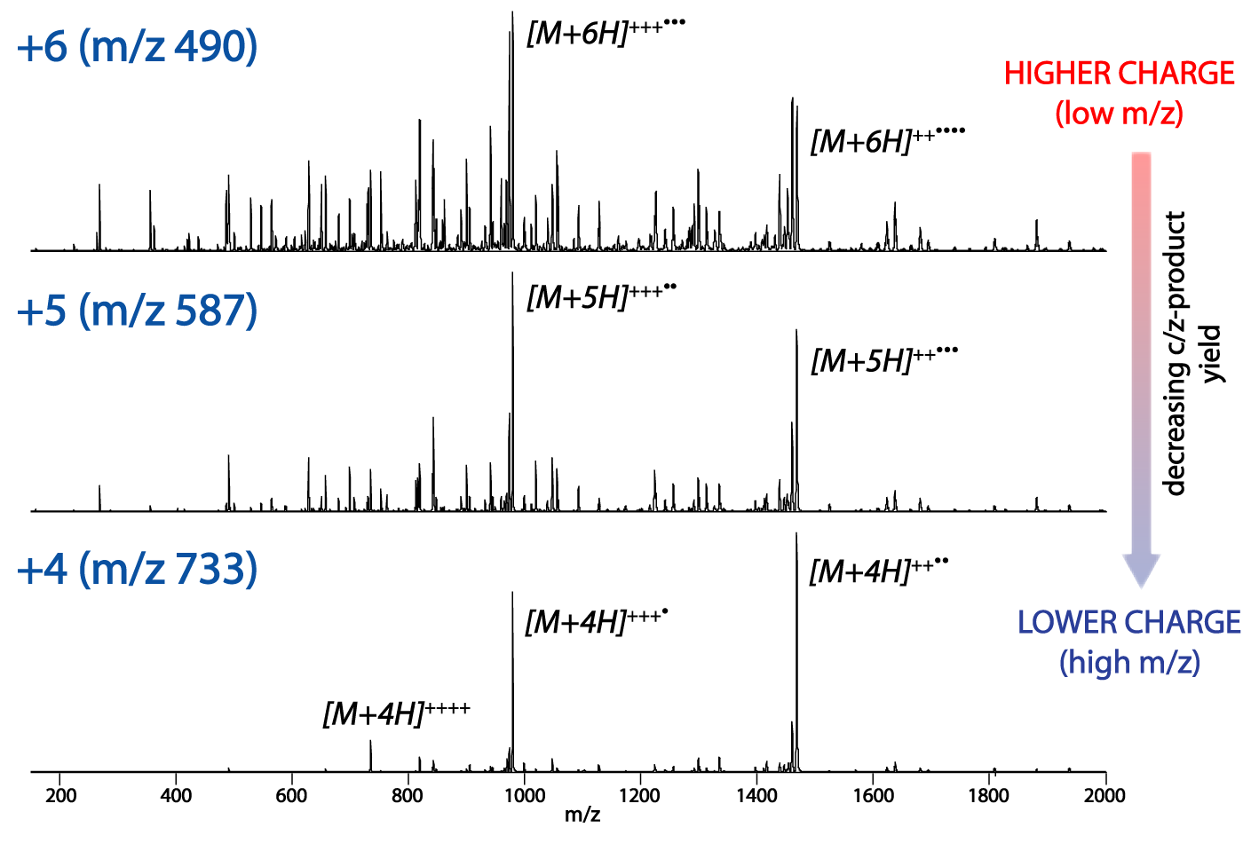
Charge dependence in fragmentation

Slide 46
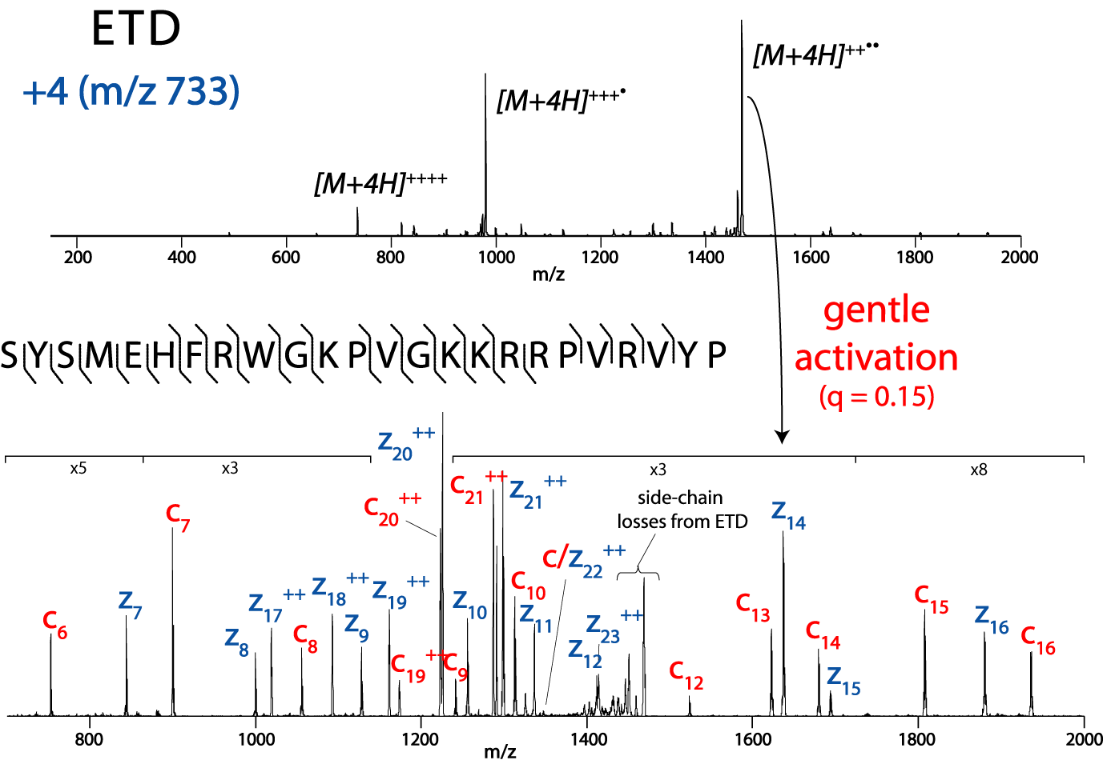
Gentle off resonance activation

Slide 47
How to Sequence ETD
Residue Mass (RM)
c1 ion
z1 ion
+ NH
c1 = RM +
18
z1 = RM +
3

Slide 48
Example of how to calculate theoretical fragment ions
105
176
307
404
517
646
803
S A M P L E R
803
700
629
498
401
288
159
The first z ion
The first c ion
Residue Mass

Slide 49
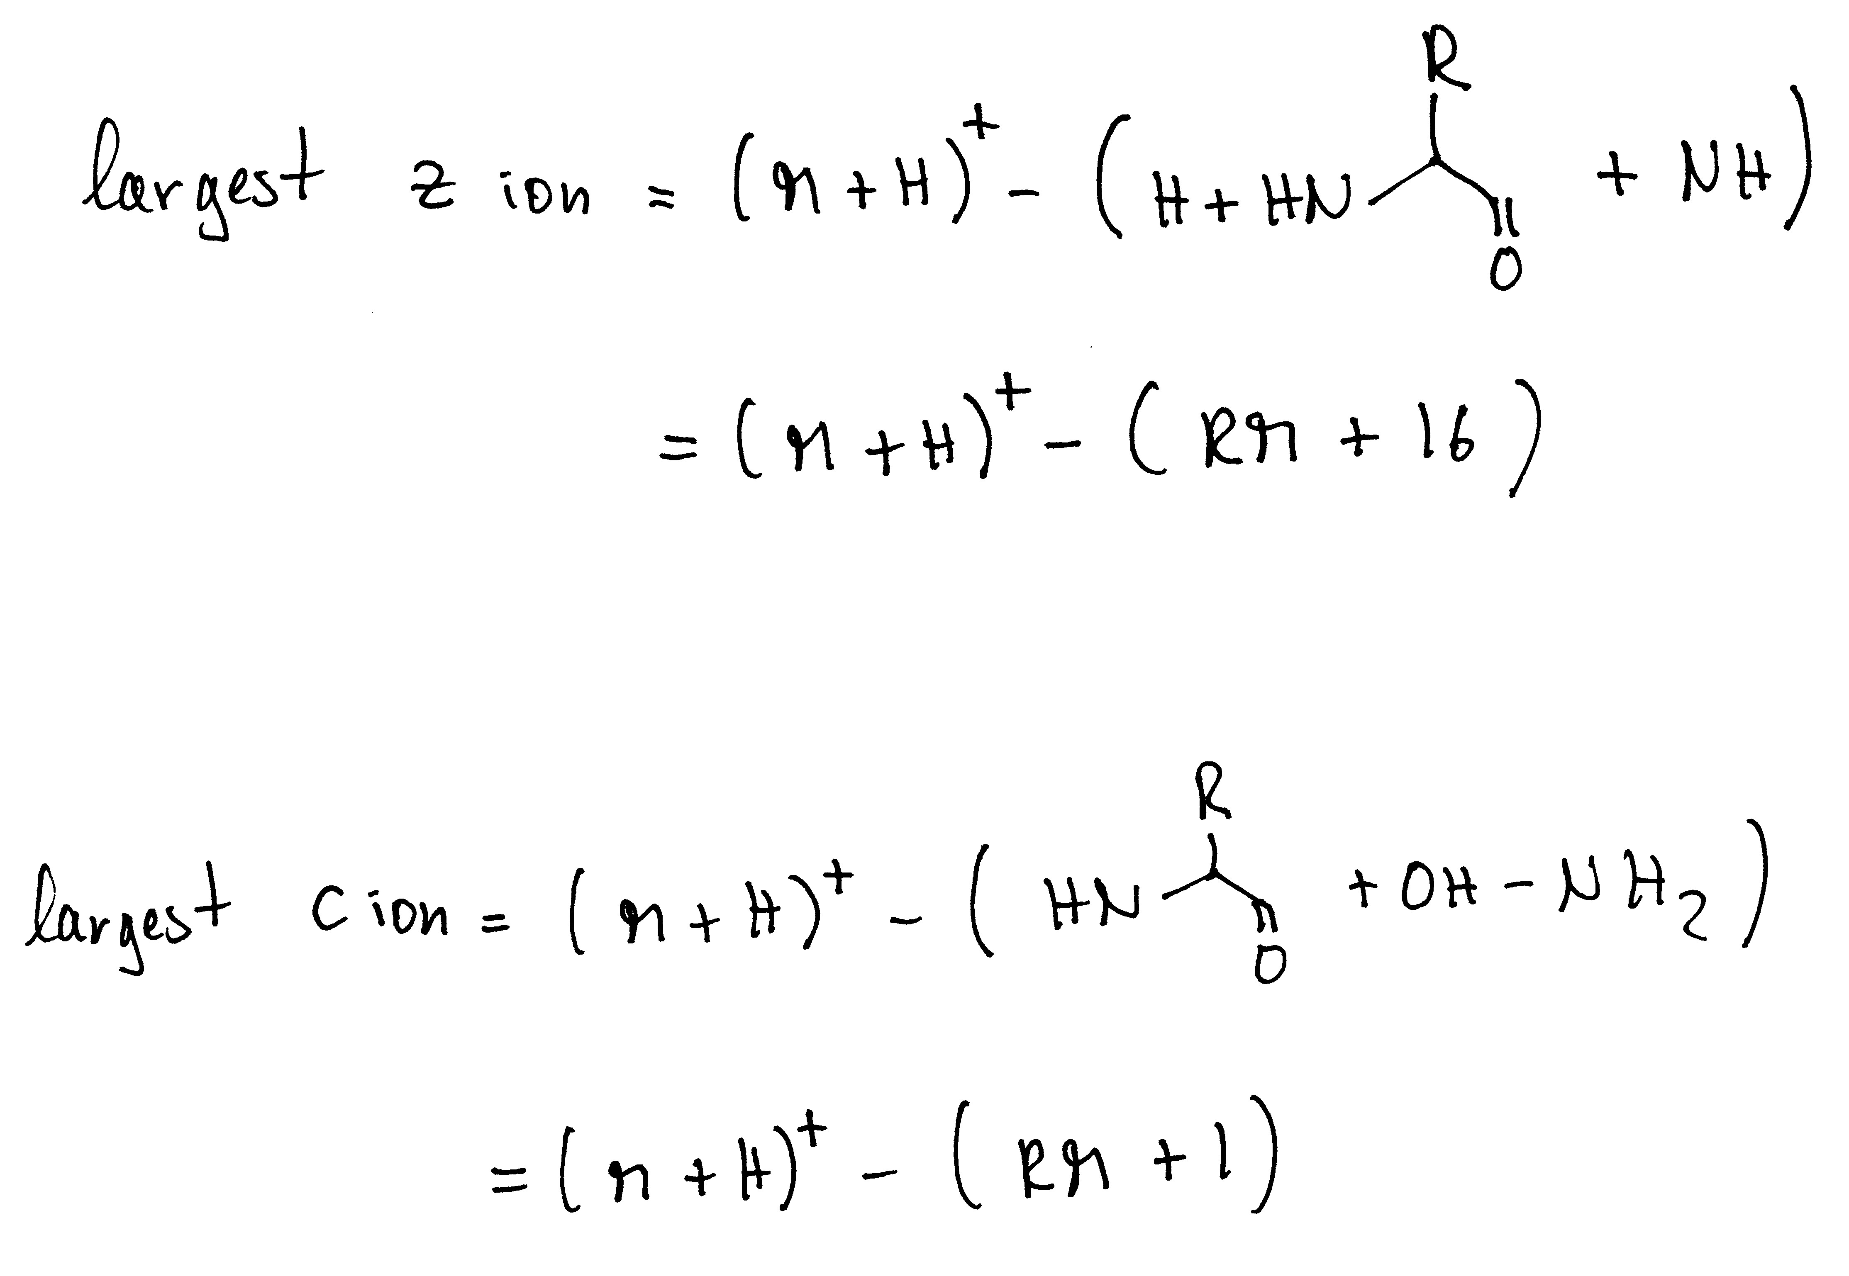
Largest c and z ions

Slide 51
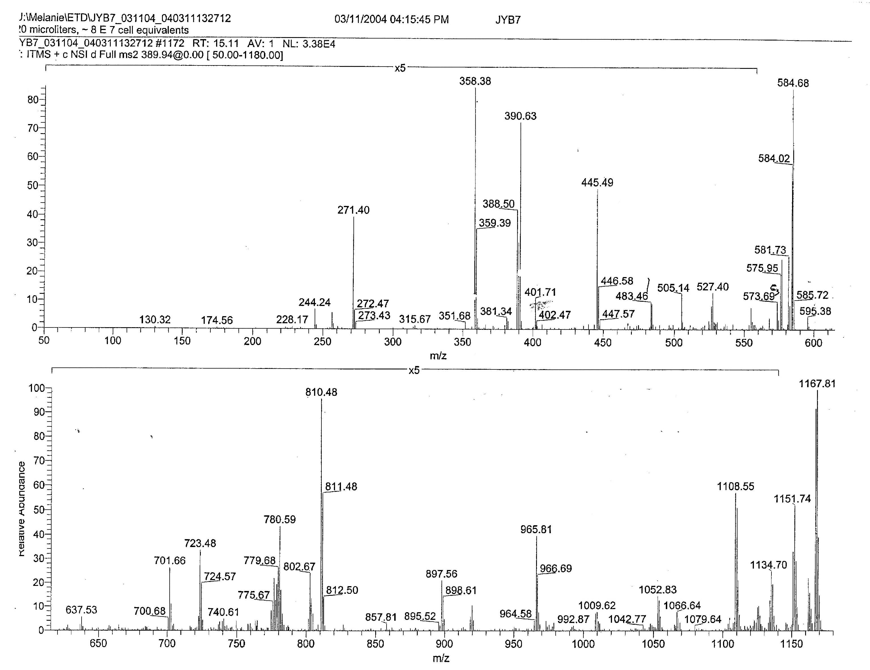
Sample: Antigens from MHC molecules: Proline in the 2nd position!

Slide 52
1. What charge state ?
[M + H]⁺¹ = m/z
(m = M + H)
Number of Hs = z
Remember to calculate with nominal masses

Slide 53
(m · z) – (z-1) = [M + H]⁺¹
(389.5 · 3) – 2 = 1166

Slide 54
(m · z) – (z-1) = [M + H]⁺¹
(389.5 · 3) – 2 = 1166
check
[M + H]⁺¹ + 1H /2
[M + 2H]⁺² = (1166 + 1) /2 = 584

Slide 55
[M + 3H]^{+3·}
+3
+2
[M + 2H]⁺²
+1

Slide 56
2. Eliminate non-sequencing relevant ions!
3. biggest c ion ?
4. biggest z ion ?

Slide 57
No suitable z_{biggest} ion! Remember 2nd position is a proline?
1052
1166
P
I/L
1166
130
c_{biggest}

Slide 58
Now find the first c ion (c₁), look for c and z pairs, and sequence ladders
Let’s find c and z pairs!
z + c = [M + H]⁺¹ +2
[M + H]⁺¹ – c + 2 = z
1052
1166
P
I/L
1166
130

Slide 59
174
271
358
445
573
701
802
965
1052
1166
R
P
S
S
Q/K
Q/K
S
T
I/L
I/L
1166
994
897
810
723
595
467
366
203
116

Slide 60
2nd Example

Slide 61
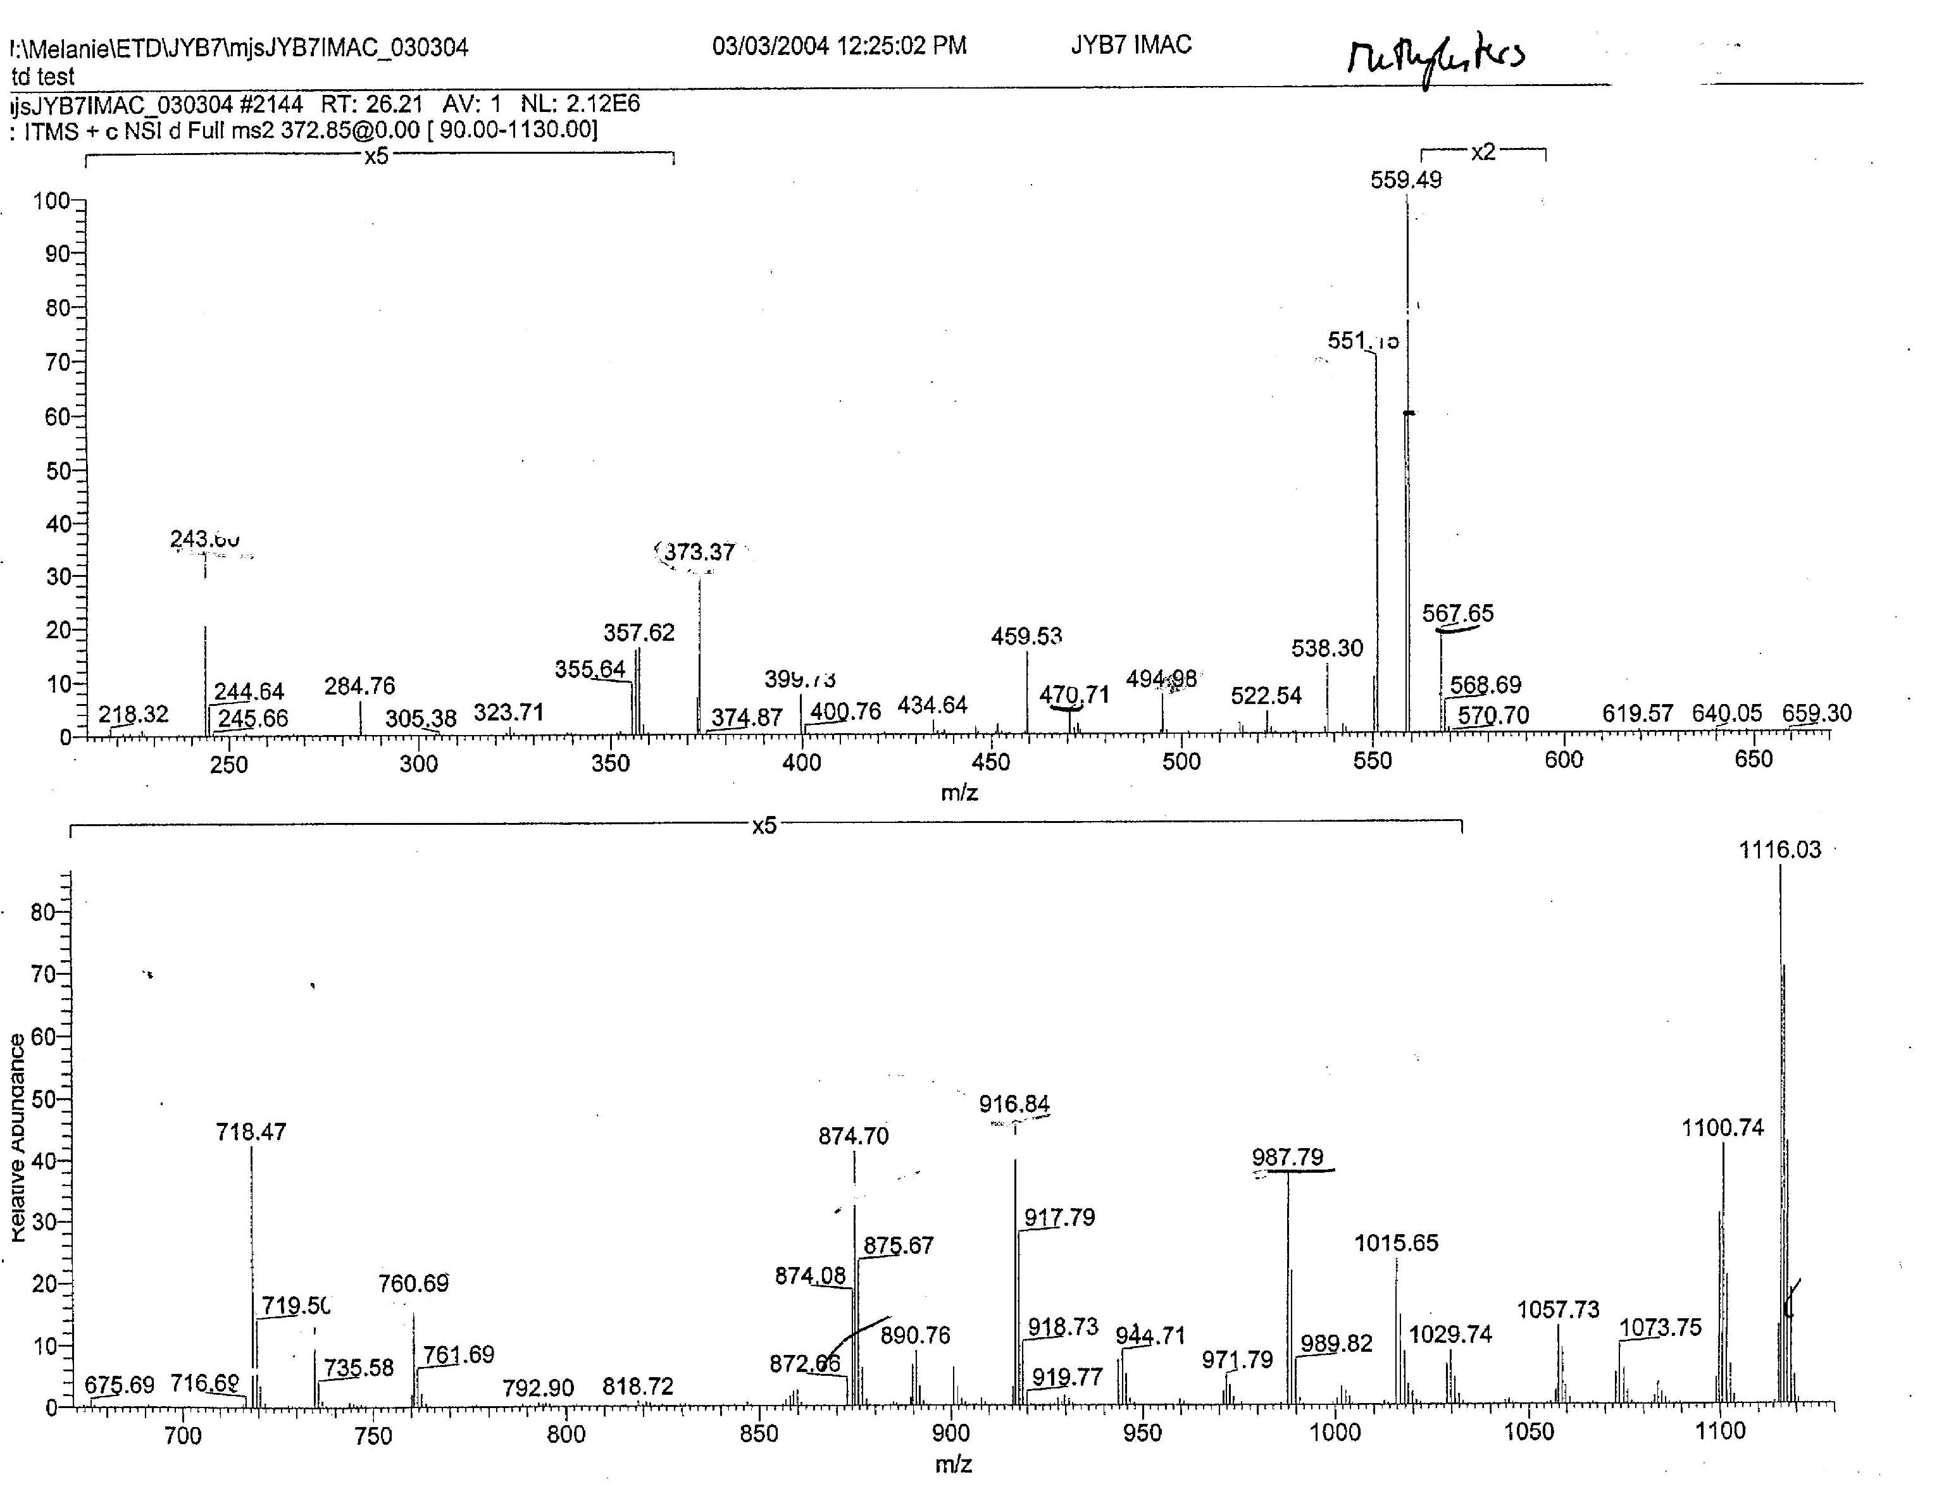
Important to know: This sample was converted to Methylesters (+14 on C-term and D/E side chains) and analyzed after IMAC!
Sample: Antigens from MHC molecules: 9mer with Proline in the 2nd position!

Slide 62
1. What charge state ?
(372.5 · 3) – 2 = 1115
check
[M + H]⁺¹ + 1H /2
= [M + 2H]⁺²
[M + 2H]⁺² = (1115 + 1) /2
= 558

Slide 63
+2
[M + 3H]^{+3·}
[M + 2H]⁺²
+3
+1

Slide 64
2. Eliminate non-sequencing relevant ions!
3. biggest c ion ?
4. biggest z ion ?
For c-ions remember to also subtract 14!

Slide 65
No suitable z₈ ion! Remember 2nd position is a proline?
c₈

Slide 66
Let’s find c and z pairs!
z + c = [M + H]⁺¹ +2
[M + H]⁺¹ – c + 2 = z
c₈

Slide 67
Let’s find c and z pairs!
z + c = [M + H]⁺¹ +2
[M + H]⁺¹ – c + 2 = z
+2
+2
130
201
c₈

Slide 68
146
243
399
760
916
987
1115
Q/K
P
R
R
A
I/L
1115
971
874
718
357
201
130

Slide 69
146
243
399
566
663
760
916
987
1115
Q/K
P
R
pS
P
P
R
A
I/L
1115
971
874
718
551
454
357
201
130

Slide 70
Second CAD Example

Slide 72
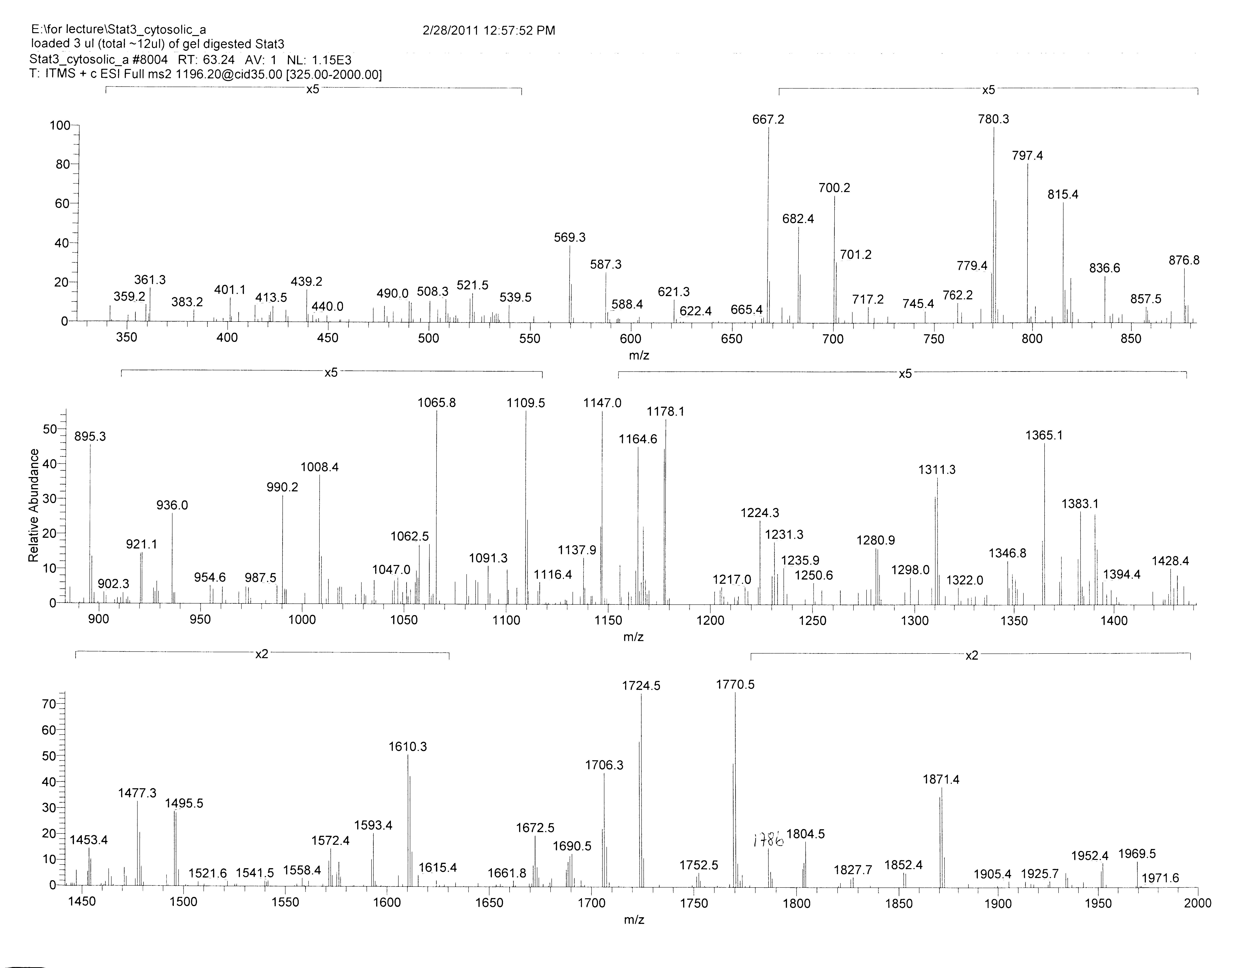

Slide 73
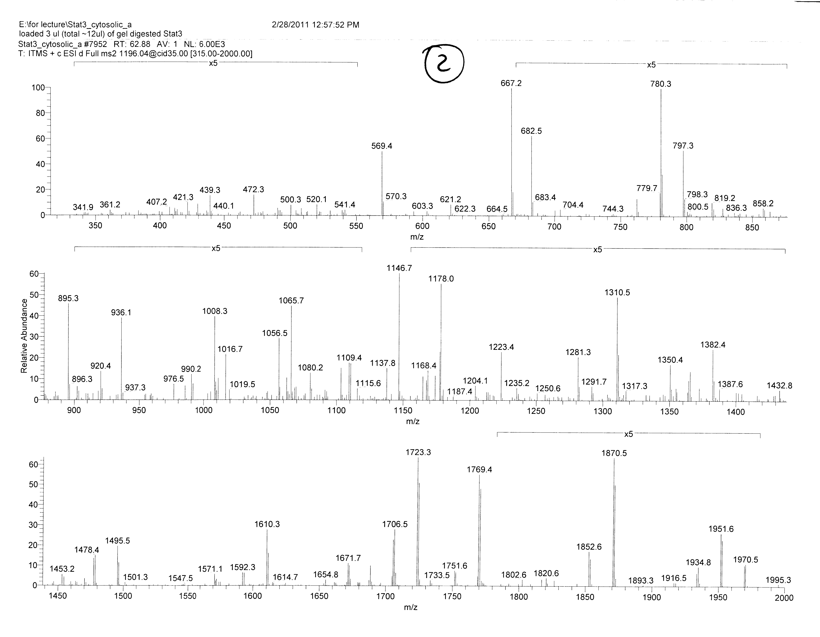

Slide 74
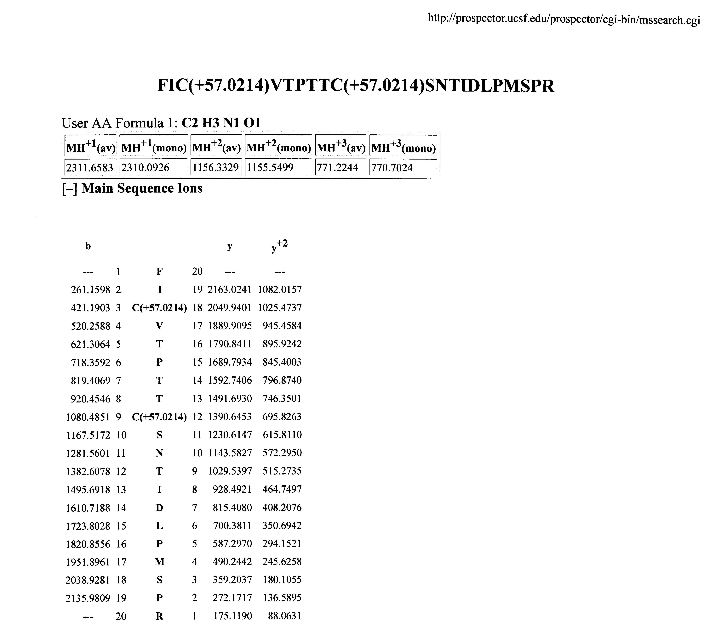

Slide 75
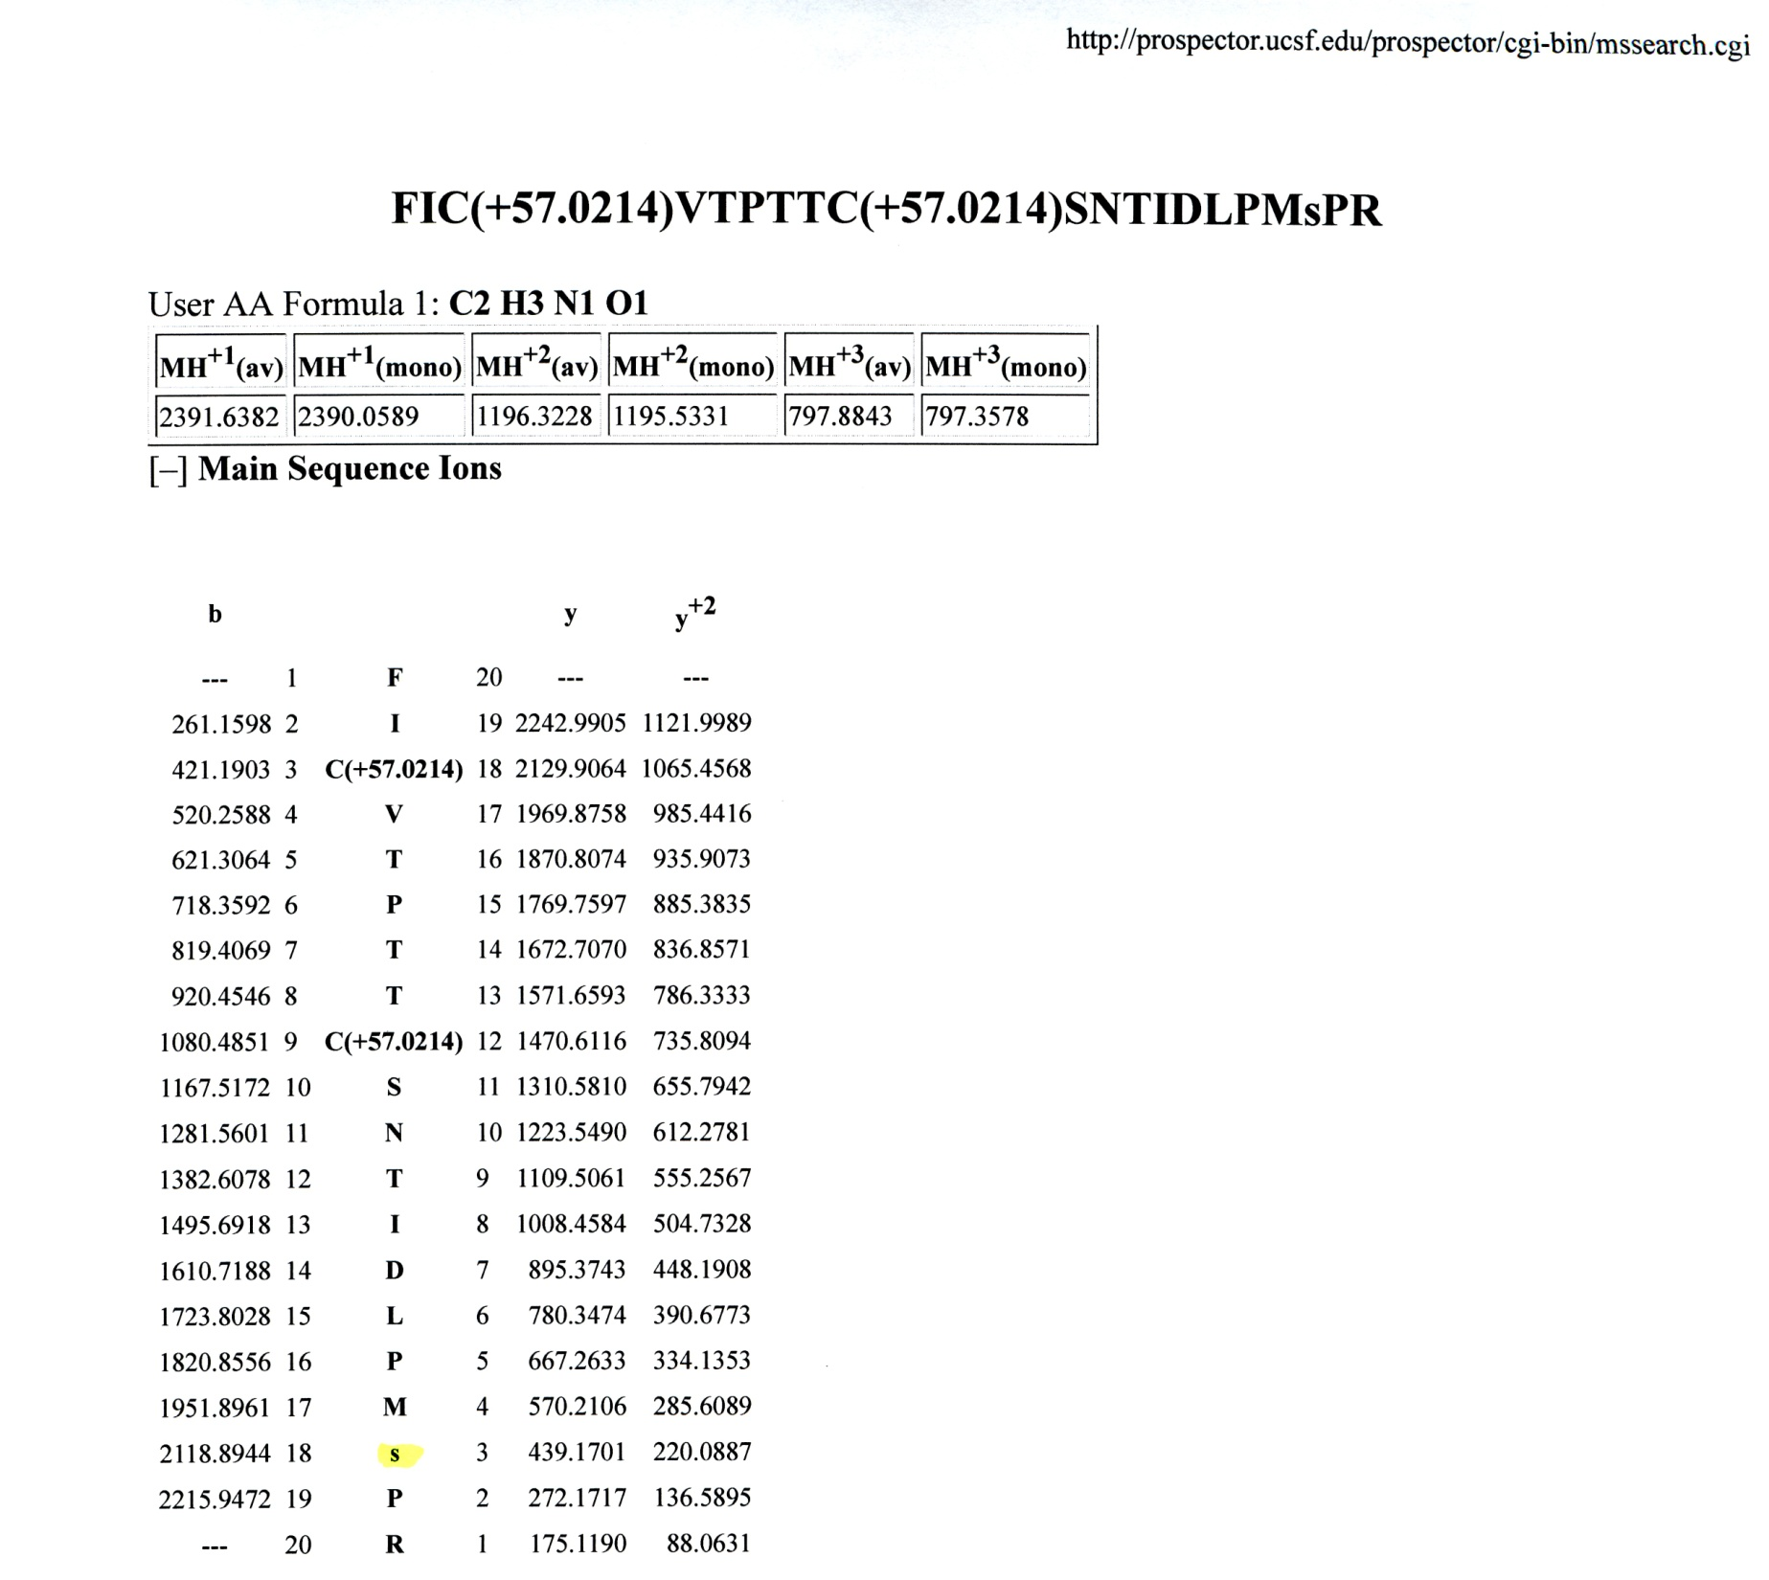

Slide 76
